Slide 1


Run open-sourced inference models in AKS using Kaito
Speaker: Jorge Arteiro & Luke Murray

Slide 2

Azure Cloud Commanders
Microsoft Learning Room

Slide 3



This session is being recorded on behalf of the Azure Cloud Commanders Learning Room. If you do not consent to be a part of a recorded session, please disconnect your line.
Recording
Notes:
Published to Youtube for later viewing for Students.

Slide 4
Code of Conduct
Inclusive session guidelines
Be welcoming and respectful
Lead with empathy
Be friendly, open, and welcoming
Be understanding of differences
Be kind and considerate to others
Audience Guidance
Use raise hand to ask a question
Questions in chat to be prefaced with Q:
@mention to respond to an individual
Return to mute when not talking
Use alt-text for images and gifs
Immersive reader can be found by clicking on … in the meeting chat

Slide 5
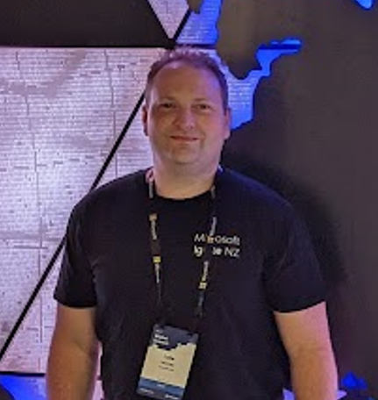
Hello!
Thank you for joining us today
Speaker: Luke Murray
Microsoft Learn Expert, and host/speaker for this session.
Microsoft Azure MVP from Hamilton, New Zealand
https://x.com/lukemurraynz
https://www.linkedin.com/in/ljmurray/
https://luke.geek.nz/

Slide 6

Hello!
Thank you for joining us today
Speaker: Jorge Arteiro
Cloud Advocate Cloud Native
@jorgearteiro

Slide 7
Every app will be reinvented with AI
New apps will be built that weren’t possible before

Slide 8
Generative AI makes apps truly intelligent
Intelligent apps
Modern apps
Natural language interaction
Data-driven, personalized experiences that improve over time
Modern app development principles
Enhances and streamlines automation
Microservices-based architecture
Rapid innovation with CI/CD

Slide 9

Modern, intelligent applications have unique requirements
Data is highly variable and unstructured
Variable, high-volume traffic
Fast, real-time, always-on digital experiences
Globally-distributed users
Notes:
So everything changed over a year and a half ago when OpenAI released chatgpt, this has probably changed the entire industry in pretty much record time. People are realizing what they can do with their data which they never realized before. And as we all know, it all starts with the data, how it is stored, organized, vectorized and accessible is going to play a large part in determining whether or they are able to use these AI technologies to provide value to society.
Modern apps and intelligent workloads have unique requirements:
The data coming in is highly variable: images, streaming video, audio, document files, telemetry from wearables/IoT/edge devices
Unpredictable traffic
Users are distributed all over the world
Users expect fast, always-on digital experiences. We need multiple services, right?
to store, vectorize, organise data in order to build AI applications.

Slide 10










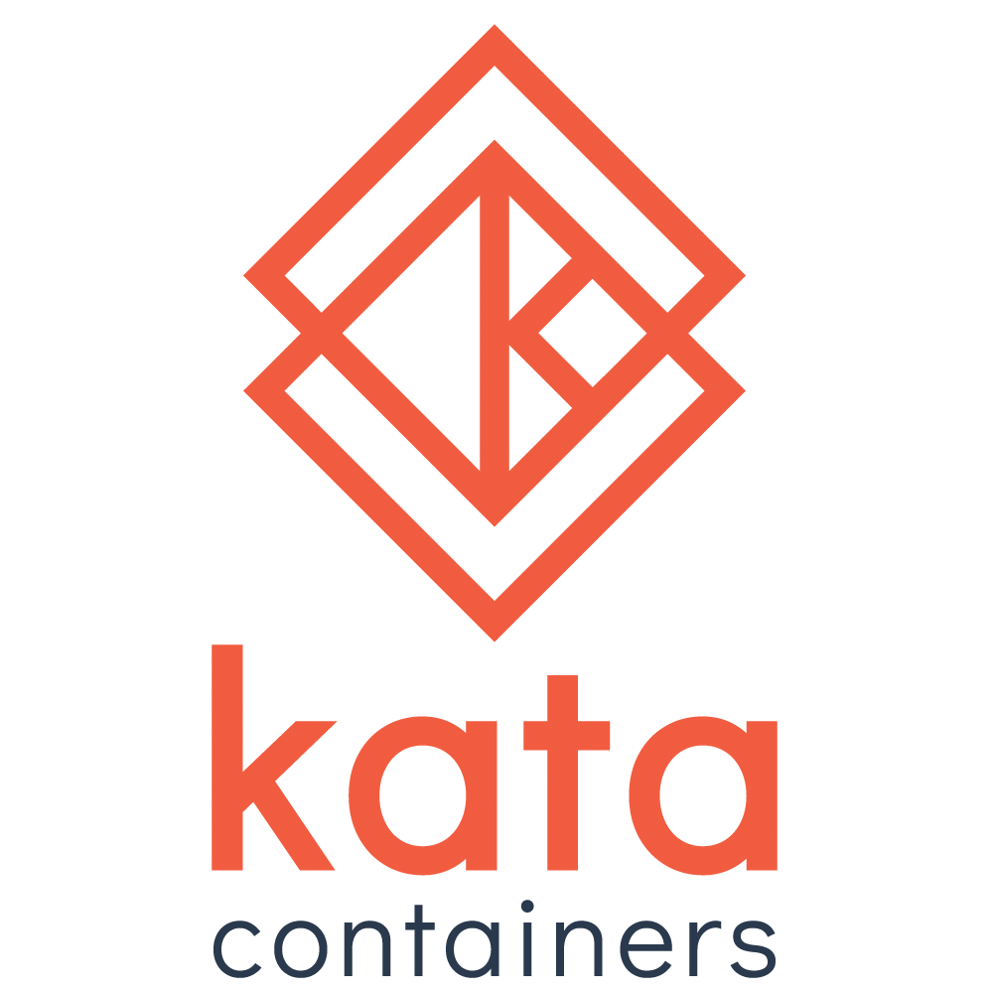

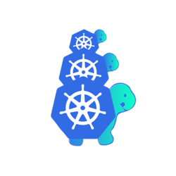



















End-to-end platform for intelligent apps
Community
Security
AI
Azure Active Directory
Azure Policy
Microsoft Defender
Azure AI services (including Azure OpenAI)
Azure Machine Learning
Azure AI Studio
Development tools
Cloud native platform
Managed databases
Storage
+
GitHub
Azure Kubernetes Service
Fleet Manager
Azure Container Apps
Azure Functions
Azure PostgreSQL
Azure Cosmos DB
Azure SQL family
Azure MySQL & MariaDB
Azure Storage
Visual Studio Code
Azure API Management
Observability
Azure Container Registry
…and more…
Azure Monitor
Azure Managed Prometheus
Azure App Insights
Azure Managed Grafana
Cloud operations anywhere
Azure Arc

Slide 11
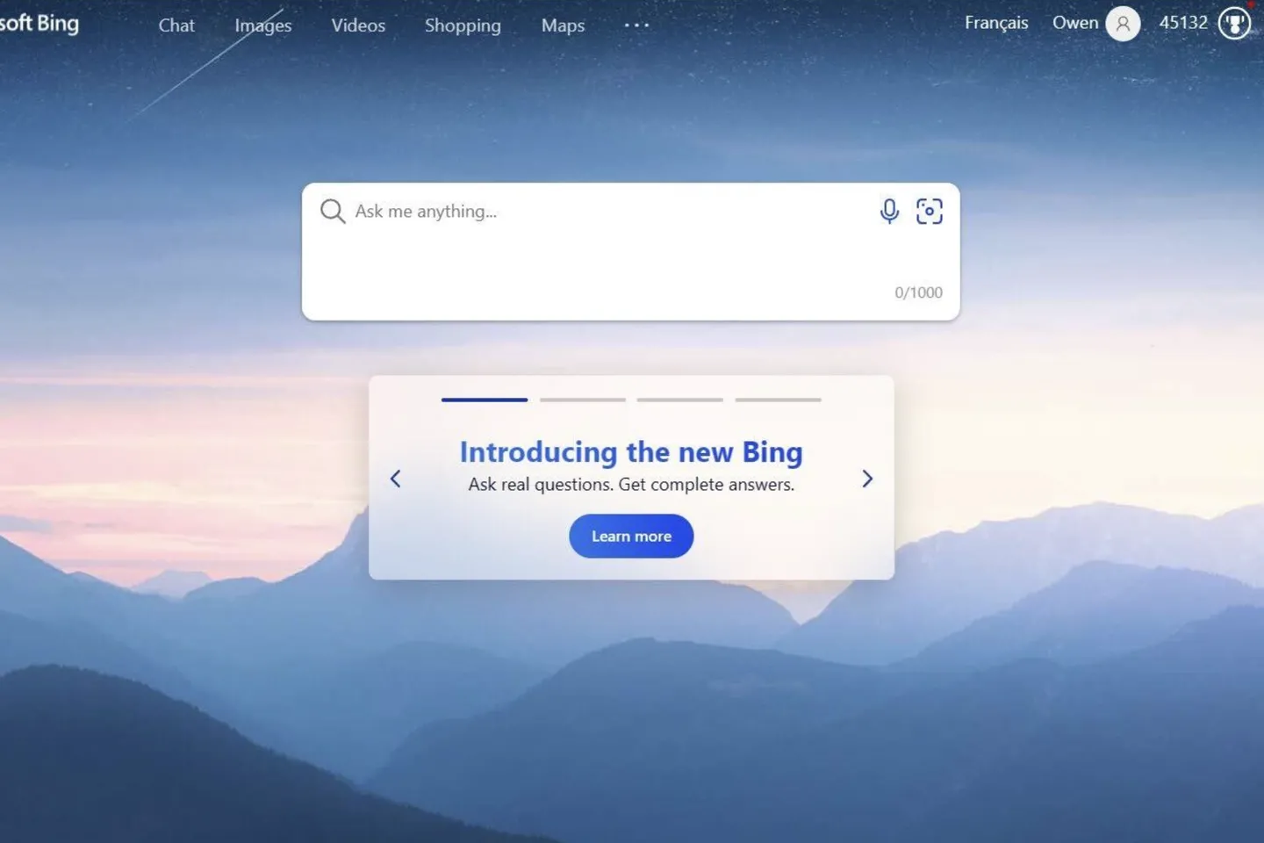
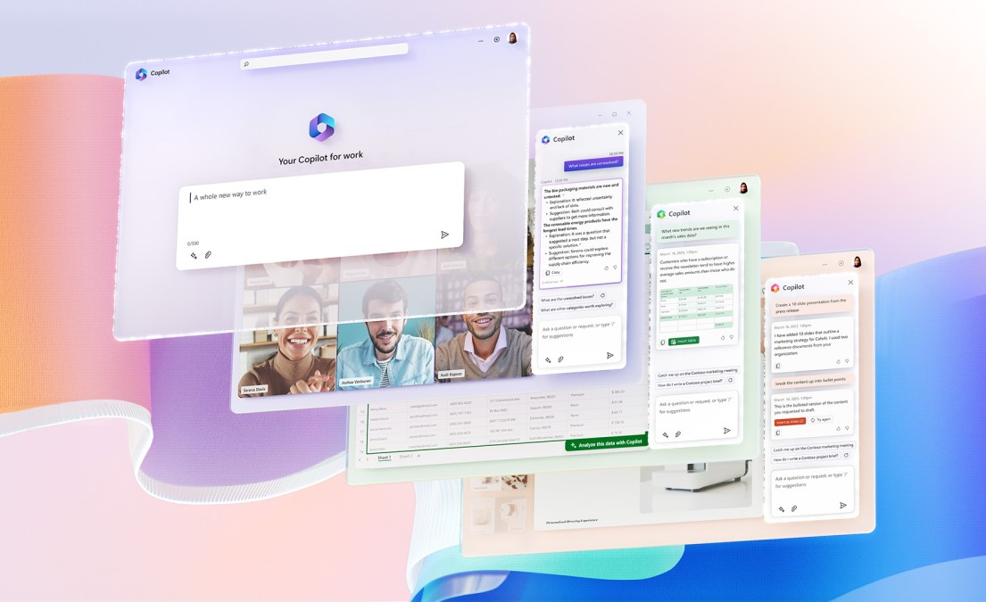

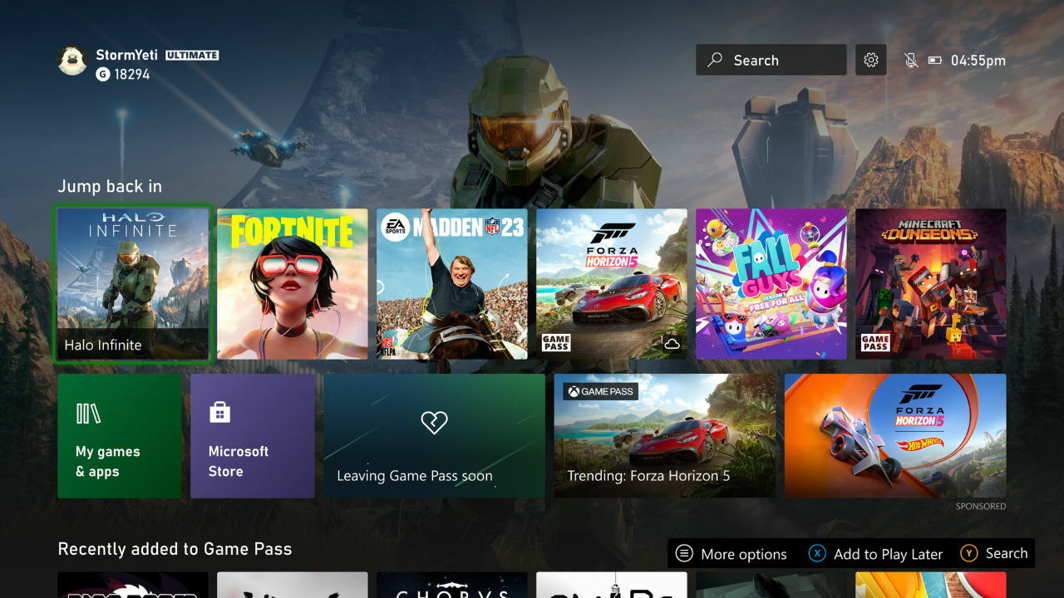
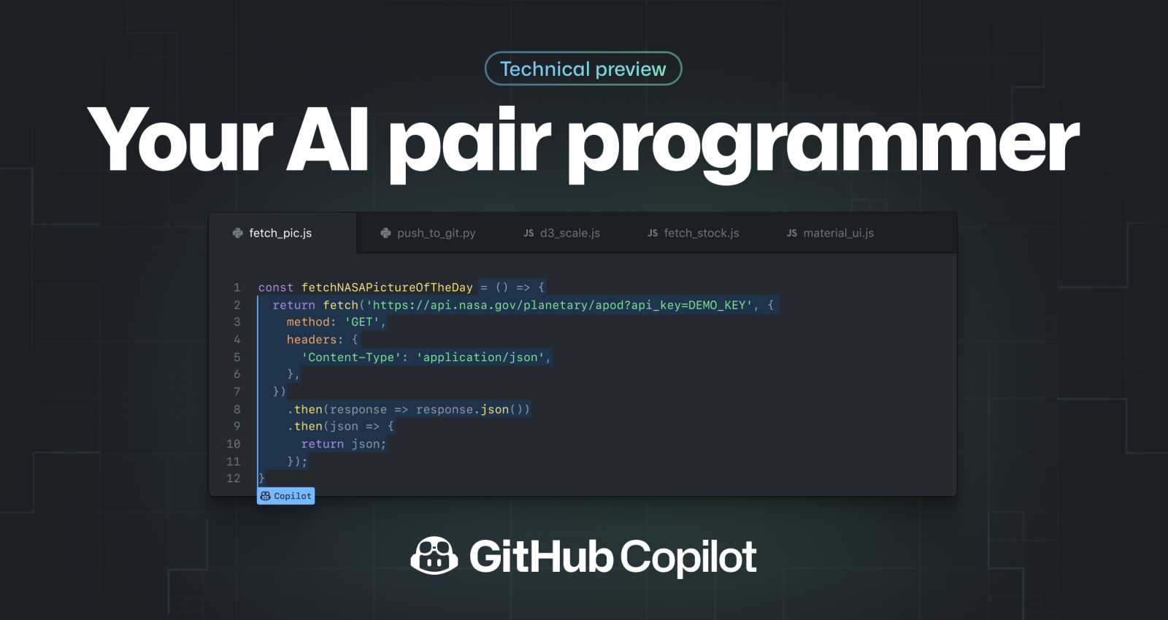
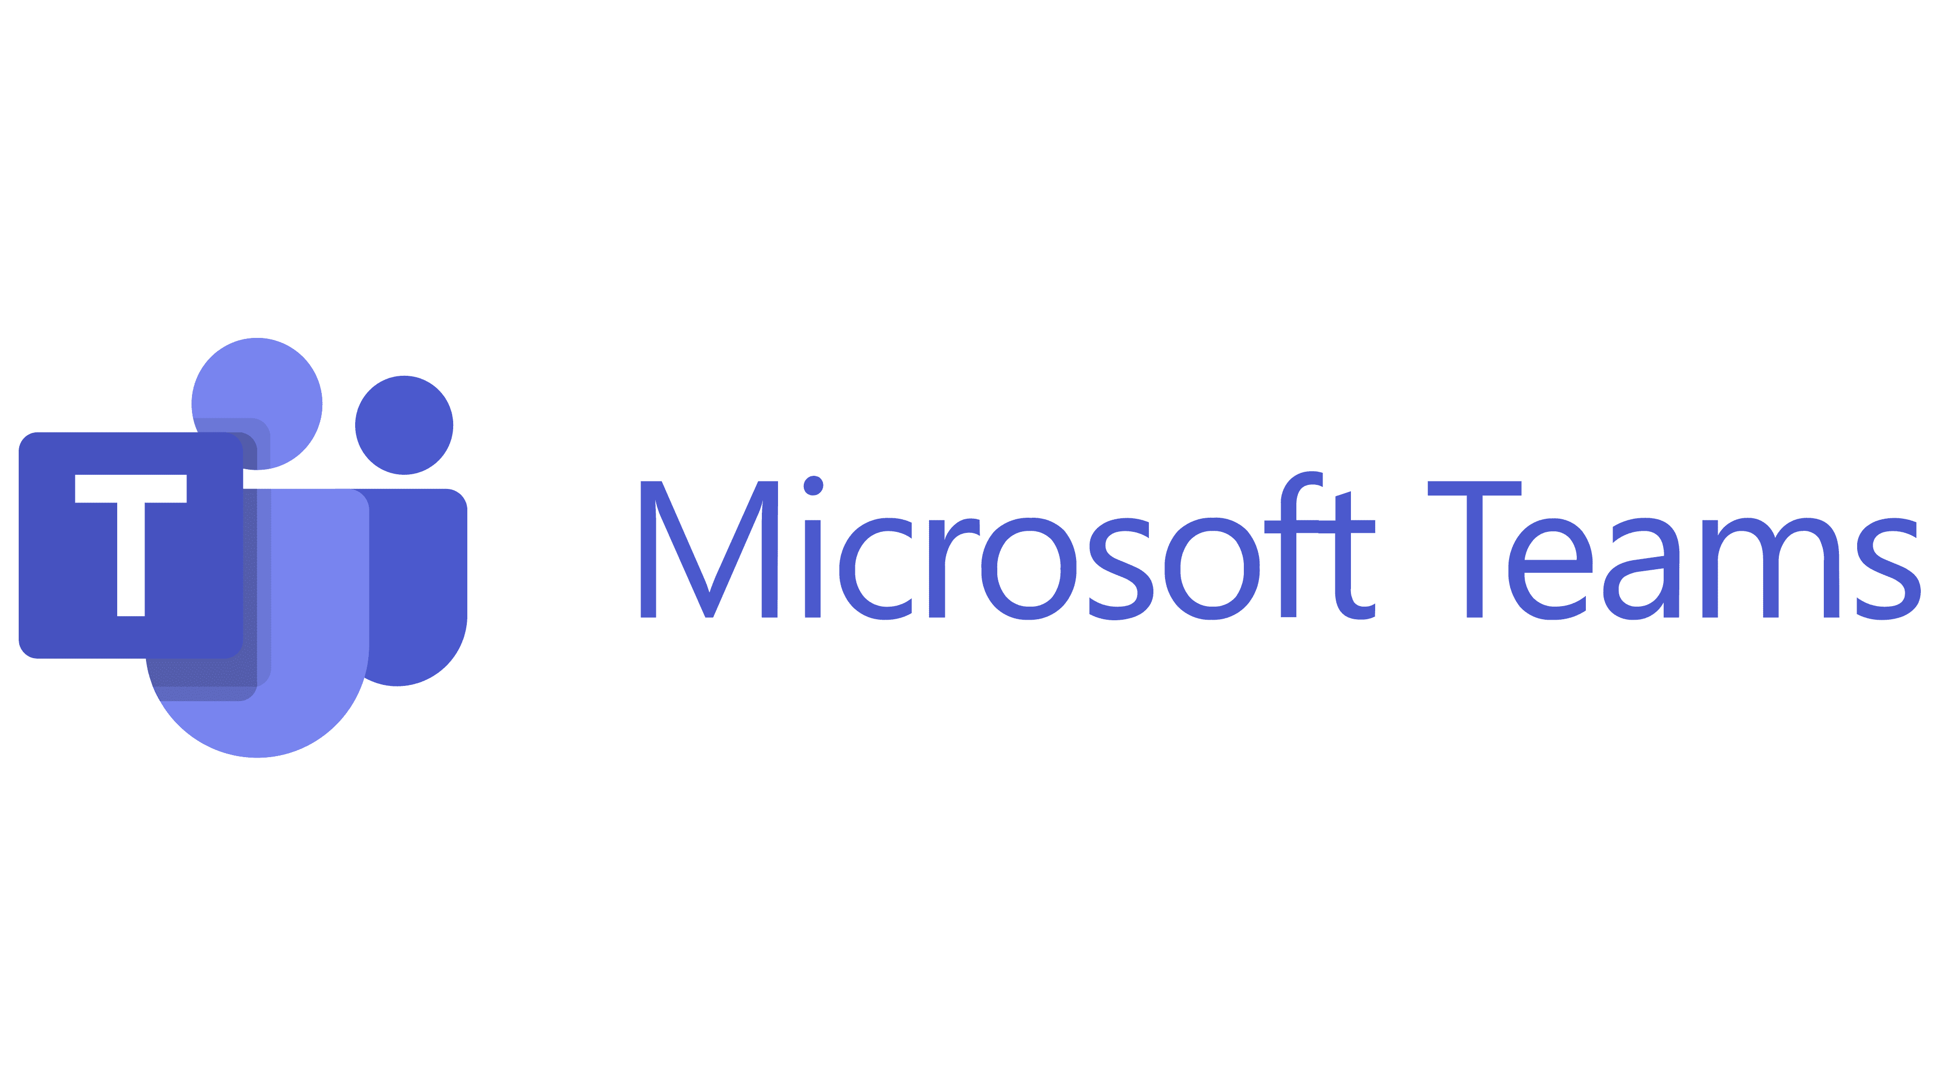




Innovate on a pressure tested platform
Microsoft modernized our own flagship apps and services for highly differentiated experiences
AI-based search with ChatGPT
Modern work across Office 365
AI-powered meeting recaps
Personalized recommendations
Copilot assisted coding

Slide 12
Azure powers OpenAI and ChatGPT
ChatGPT
Runs on Azure Kubernetes Service (AKS)
Backed by Azure Cosmos DB
Developed on GitHub
Fastest growing consumer product in history

Slide 13



AKS provides a modern platform for intelligent apps
Choice
Integrated with IDEs for
your favorite framework/language, bring your code or container
Integrated CI/CD
Delivery w/ GitHub AS, GitHub Actions, Azure DevOps, and others
Blue-green deploys
Seamlessly rollout new versions of apps for user testing or change management while maintaining uptime
Reliability and scale
Autoscale, high availability with a service-level agreement (SLA)-backed uptime, continuous backups
Patching/upgrade
Automatic platform maintenance and security patching. Rolling updates w/o downtime, version pinning, rollbacks
Observability
System insights for faster issue resolution, health checks
Security
Policy enforcement, RBAC, secrets management, authN and authZ, secure container supply chain
Self healing and resilience
Health checks and self healing of unhealthy apps, harden using chaos engineering principles, and load testing tools
Managed operations
Opinionated and simplified operations through a fully managed service. Managed addons, nodes & lifecycle

Slide 14
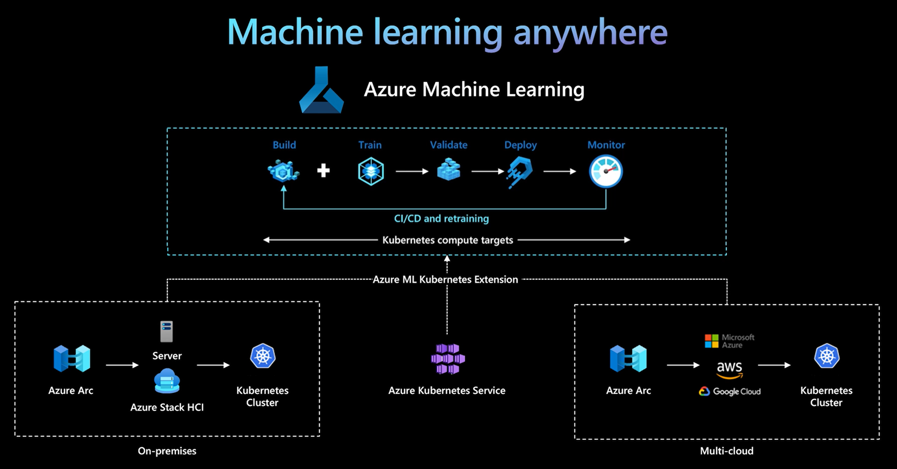





Machine learning on AKS + Azure ML
Azure Machine Learning
Build
Train
Validate
Deploy
Monitor
CI/CD and retraining
Kubernetes compute targets
Azure ML Kubernetes Extension
Server
Azure Arc
Kubernetes Cluster
Azure Arc
Kubernetes Cluster
Azure Stack HCI
Azure Kubernetes Service
On-premises
Multi-cloud

Slide 15











Unified Dev and Ops of at-scale cloud and edge environments
Azure
Azure AI and Data Services
Azure Container Registry
Azure Policy
Code
GitHub
Actions (CI/CD)
Azure Kubernetes Fleet Manager
Azure Kubernetes
Service [AKS]
Azure Monitor
Datacenter, Edge

Slide 16
Kubernetes LLM inferencing - current user experience
1
Download/store the large model weights (200-400GB in size)
Expensive memory requirements
Long wait times to load the files
2
Create a container file to reduce model weights and model image using a Container engine
Disjointed steps, may take users several weeks
3
Host the model image
4
Provision the necessary GPU infrastructure
5
Set up the inference server as an app endpoint service
6
Troubleshoot any shared GPU quota limitations

Slide 17




AI toolchain operator (KAITO) add-on for AKS
Public preview
Deploy
Inference
Innovate
AI toolchain operator add-on for AKS
Workspace and infra setup to model inferencing
in a matter of minutes
Load model weights
Model Containerization
Host image
Provision GPU infra

Slide 18



Demo – Contoso Pet Supplies
Azure Container Registry
Code
GitHub
Actions (CI/CD)
Azure Kubernetes Fleet Manager
Azure Kubernetes
Service [AKS]
Service Bus Queue
Cosmos DB
Identity
RBAC
order-service
makeline-service
product-service
Monitoring
AI toolchain operator
store-admin
store-front
ai-service
Azure OpenAI
Policy

Slide 19
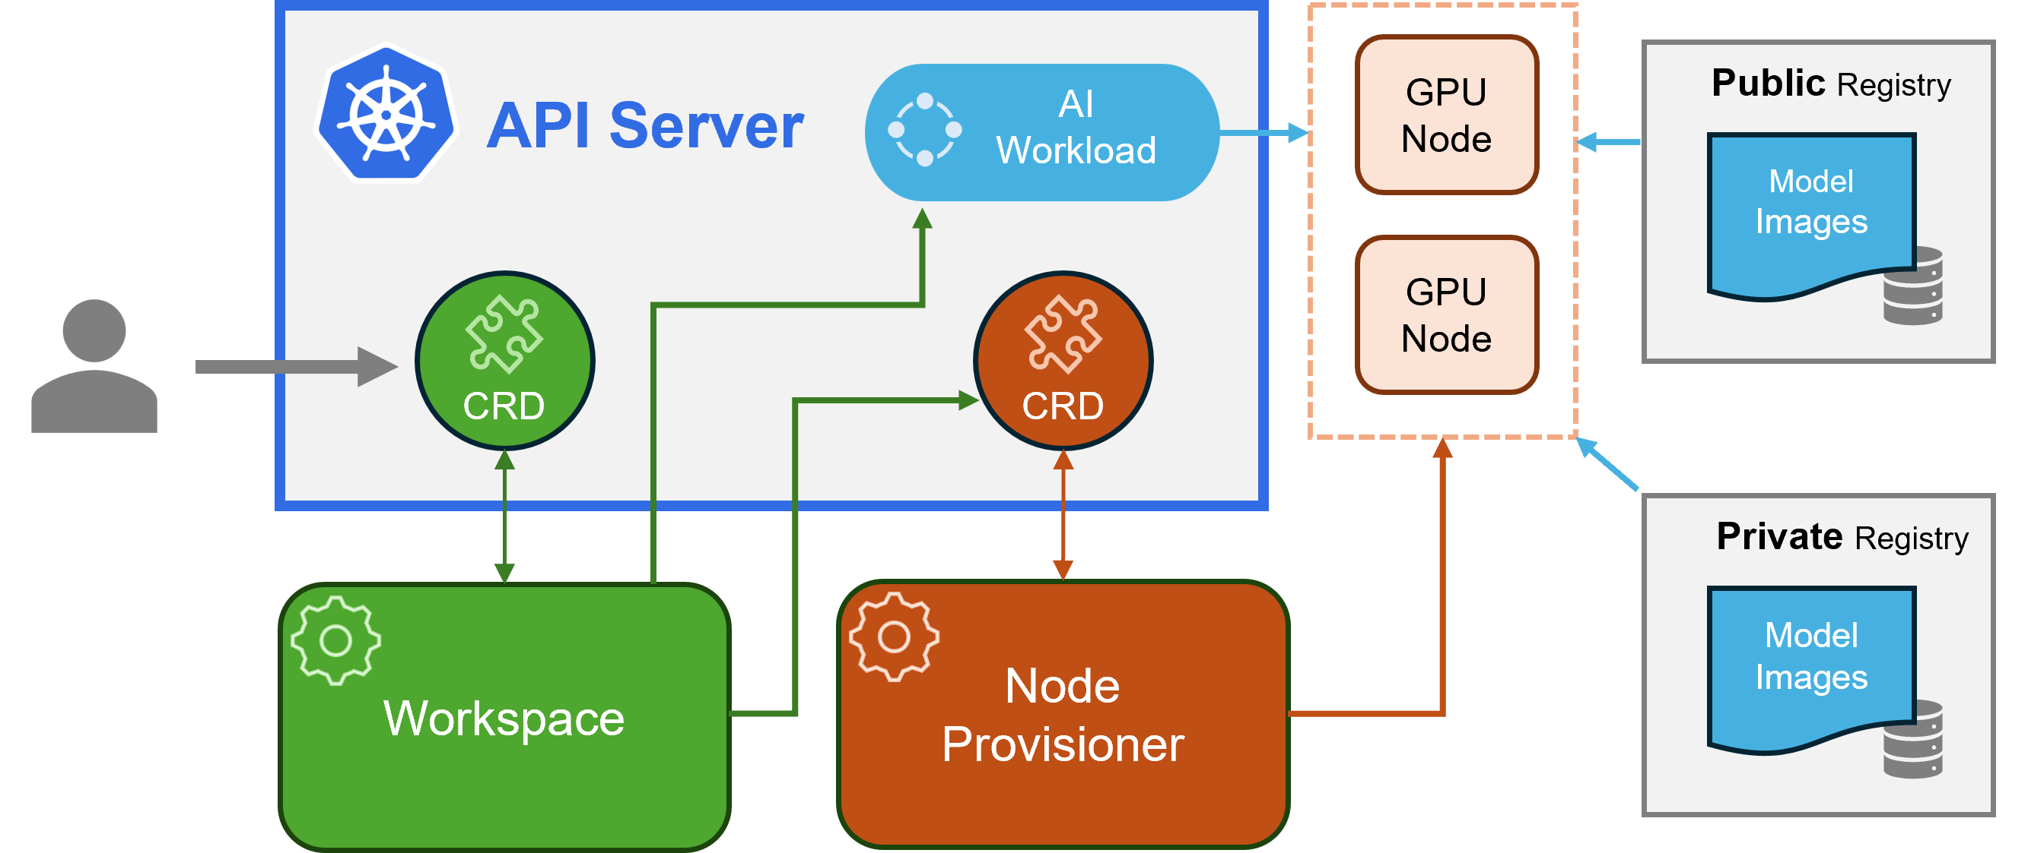
Notes:
Kaito follows the classic Kubernetes Custom Resource Definition(CRD)/controller design pattern. User manages a workspace custom resource which describes the GPU requirements and the inference specification. Kaito controllers will automate the deployment by reconciling the workspace custom resource.
The above figure presents the Kaito architecture overview. Its major components consist of:
Workspace controller: It reconciles the workspace custom resource, creates machine (explained below) custom resources to trigger node auto provisioning, and creates the inference workload (deployment or statefulset) based on the model preset configurations.
Node provisioner controller: The controller's name is gpu-provisioner in gpu-provisioner helm chart. It uses the machine CRD originated from Karpenter to interact with the workspace controller. It integrates with Azure Kubernetes Service(AKS) APIs to add new GPU nodes to the AKS cluster.

Slide 20
Kaito Supported Models
llama-2-7b
The successor to LLaMA (henceforce "Llama 1"), Llama 2 was trained on 40% more data, has double the context length, and was tuned on a large dataset of human preferences (over 1 million such annotations) to ensure helpfulness and safety.
falcon-7b
Falcon LLM is a powerful LLM developed by the Technology Innovation Institute (https://www.tii.ae). Unlike other popular LLMs, Falcon was not built off of LLaMA, but instead using a custom data pipeline and distributed training system.
mistral-7b
Mistral AI offers 7B and a mixture-of-experts 8x7B open-source models competitive or better than commercial models of similar size. Available under the Apache 2.0 license, the Mistral models are now also available via most cloud vendors.
phi-2
Phi-1 and Phi-2 are 1.3B and 2.7B parameter language models, respectively, developed by Microsoft to demonstrate the ability of smaller language models trained on high-quality data.
Notes:
The main distinction lies in their intended use cases. Instruct models are fine-tuned versions optimized for interactive chat applications. They are typically the preferred choice for most implementations due to their enhanced performance in conversational contexts. On the other hand, non-instruct, or raw models, are designed for further fine-tuning.
Kaito has the following key differentiations compared to most of the mainstream model deployment methodologies built on top of virtual machine infrastructures:
Manage large model files using container images. A http server is provided to perform inference calls using the model library.
Avoid tuning deployment parameters to fit GPU hardware by providing preset configurations.
Auto-provision GPU nodes based on model requirements.
Host large model images in the public Microsoft Container Registry (MCR) if the license allows.
Using Kaito, the workflow of onboarding large AI inference models in Kubernetes is largely simplified.
https://huggingface.co/models
Reason is smaller, Mistral has multiple agents working.

Slide 21
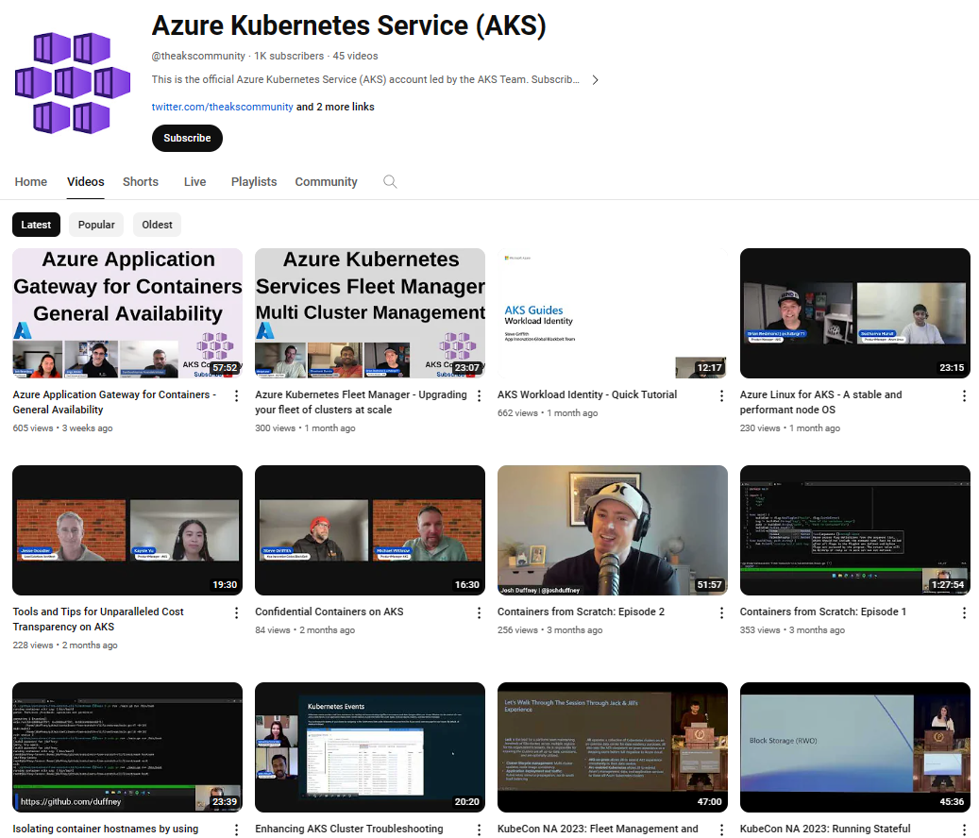

Be sure to subscribe!
@TheAKSCommunity
The official YouTube channel led by the AKS team
Continue your learning with AKS!
https://aka.ms/TheAKSCommunity

Slide 22






You’ve earned it!
Thank you for joining us today. You’ve gained new skills and have earned a new Microsoft Learn achievement badge.
Scan the QR code
Sign in to your Microsoft Learn profile
Use redemption code R7V2PJ when prompted
Share your new badge on your social platforms
#MSBuild

Slide 23
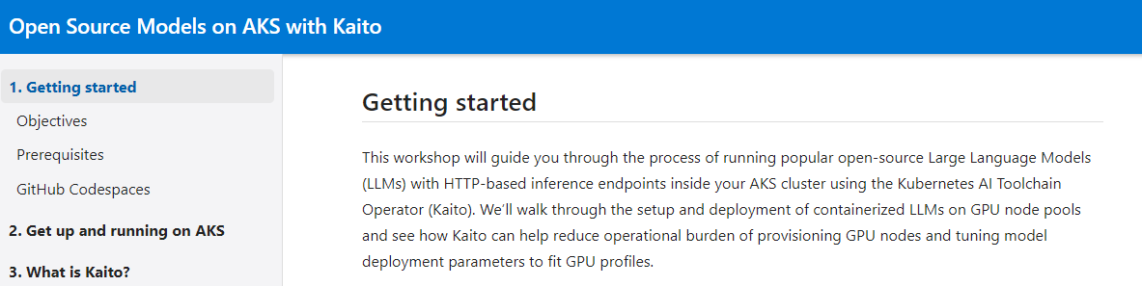
Notes:
https://moaw.dev/workshop/?src=gh%3Apauldotyu%2Fmoaw%2Flearnlive%2Fworkshops%2Fopensource-models-on-aks-with-kaito%2F&step=0

Slide 24


